Slide 1
DVB SIS development environment Config #1
In-band CSG signalling (via MUX)
Can be:
Dektec Stream player
Later maybe TS Duck
VLC player
Wireshark???
Can be:
Dektec MUX
Later maybe TS Duck
GPS PCIe receiver
DSA @ Supermicro 1RU
Debian
DVB SIS
DSA processing
TBSD PCIe DVB-S2 sat receiver
Win PC - Analyzer
DVB-S2 Modulator
DTA-107 PCIe
DVB-S2 sat receiver DTA-2127
Stream Player (MPEG stream)
30 Mbps
MUX
DVB-ASI
DTA-2145 PCIe
DVB-ASI
DTA-2145 PCIe
DVB-ASI
DTA-2145 PCIe
Stream Analyzer
TSoIP or IP Ethernet
TSoIP / IP Ethernet
TSoIP /IP Ethernet
DVB-T/T2 modulator
CSG
XML, DSACI
50 kbps
DVB ASI or IP
GPS PCIe receiver
CSG metadata are multiplexed as Private Sections - not interfering satellite DTH receivers
This is then: In band SIGNALLING
VM with Debian at Supermicro server
Optionaly it may require
GPS PCIe receiver
PTP via Serial port
Output a) IP or b)

Slide 2
DVB SIS development environment Config #2
Out-band CSG signalling (via MUX)
Can be:
Dektec Stream player
Later maybe TS Duck
VLC player
Wireshark???
Can be:
Dektec MUX
Later maybe TS Duck
GPS PCIe receiver
DSA @ Supermicro 1RU
Debian
TBSD PCIe DVB-S2 sat receiver
Win PC - Analyzer
DVB-S2 Modulator
DTA-107 PCIe
DVB-S2 sat receiver DTA-2127
DVB SIS
DSA processing
Stream Player (MPEG stream)
30 Mbps
MUX
DVB-ASI
DTA-2145 PCIe
DVB-ASI
DTA-2145 PCIe
DVB-ASI
DTA-2145 PCIe
Stream Analyzer
TSoIP out Ethernet
TSoIP Ethernet
TSoIP out Ethernet
DVB-T/T2 modulator
CSG
XML, DSACI
50 kbps
GPS PCIe receiver
VM with Debian at Supermicro server
Optionaly it may require
GPS PCIe receiver
PTP via Serial port
Output a) IP or b)
CSG metadata are sent via separate network
This is then: Out-band SIGNALLING

Slide 3
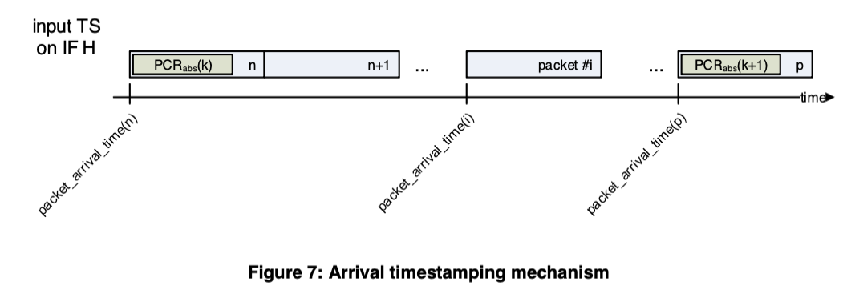
First functional DVB SIS prototype DVB-T
Sat DTH
MPEG TS
DSA #1
6.3.1 Arrival timestamping PCR_{(Abs)}
Region 1 MUX
TV #1
TV #1
5.7.3.3. Remultiplexing
TV #1
TV #2
TV #2
TV #2
TV #3
TV #3
TV #3
TV #4
TV #4
TV #4
TV #5
TV #5
Reference TS with PCR (abs)
PCR0(abs)
Ref TS with Timestamping PCR_{(Abs)}
Region 2 MUX
Reference TS with PCR (abs)
XML config file:
MIP megaframe (L1)
Service list
Reference TS with PCR (abs)
TV #1
TV #2
TV #3
TV #5

Slide 4
I. module – DVB-T TIMESTAMPING with PCR (Abs)
CSG – generation of dummy Reference MPEG TS with Timestamps PCR (abs) with consequent null packet deletion.
DSA – inserting PCR(abs) for each incoming packet
We will just follow GPS Epoch format, even not yet precise timestamping.

Slide 5
DVB-T II. module – MULTIPLEXING using PCR (Abs)
CSG – generate DSACI – configuration of Multiplexer for Region 1, 2
DSA – deterministic remultiplexing based on PCR (abs) and rules defined in standard
We will just follow GPS Epoch format, even not yet precise timestamping.

Slide 6
III. module – DVB-T2 L1 signalling with TIMESTAMPING with PCR (Abs)
CSG:
generation of L1 signalling T2-MI dummy stream
generation of dummy Reference MPEG TS with Timestamps PCR (abs) with consequent null packet deletion.
DSA – inserting PCR(abs) for each incoming packet
We will just follow GPS Epoch format, even not yet precise timestamping.

Slide 7
DVB-T2 IV. module – MULTIPLEXING using PCR (Abs)
CSG – generate DSACI – configuration of Multiplexer for Region 1, 2
DSA
deterministic remultiplexing based on PCR (abs) and rules defined in standard
Creating DVB-T2 MI according to L1 signalling
We will just follow GPS Epoch format, even not yet precise timestamping.

Slide 8
DVB-T/T2 framing corresponds to modulation and coding FEC
DVB-T/T2 Modulation and coding dictates BITRATE (see standard)
Sum of bitrates for selected DTH services MUST FIT into this BITRATE
(satellite DTH may have 55 Mbps, DVB-T2 only 30 Mbps)
PSI/SI tables of DTH stream differs from DVB-T/T2 simply because there are different TV services in satellite and terrestrial multiplex
DSA must know which services it has ”to take” from satellite DTH and insert into terrestrial multiplex, this is in CSG config file
DSA must modify minimally PSI/SI tables, minimally delete PMT tables. This modification has to be done deterministically as well.

